Slide 1

BOBI Tool shop website
Dunai Krisztián – Balogh Ádám

Slide 2
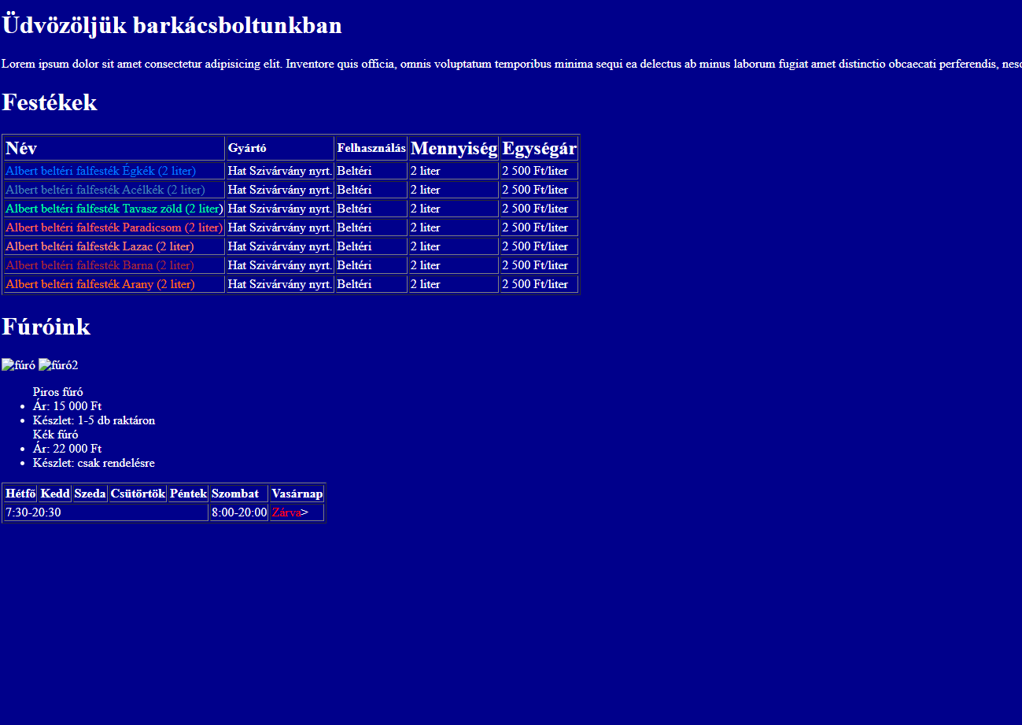
Customer requirement’s
Responsive website
HTML5-, CCS5 standard
Old site is outdated, must be validated to HTML5- standard
Main page
Paints
Wood materials
Tools
Blog
About us

Slide 3
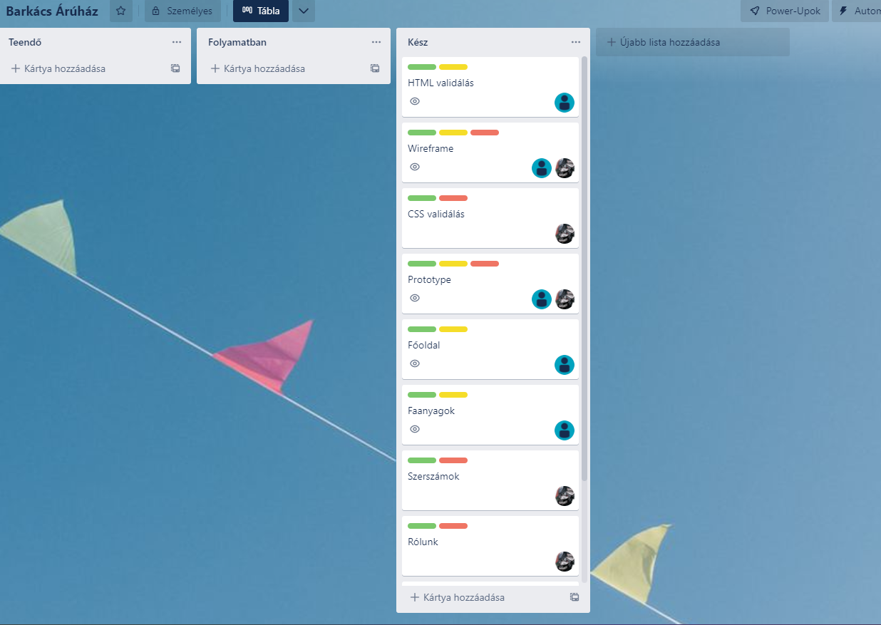
Tools
Figma
Trello
Github
Bootstrap

Slide 4
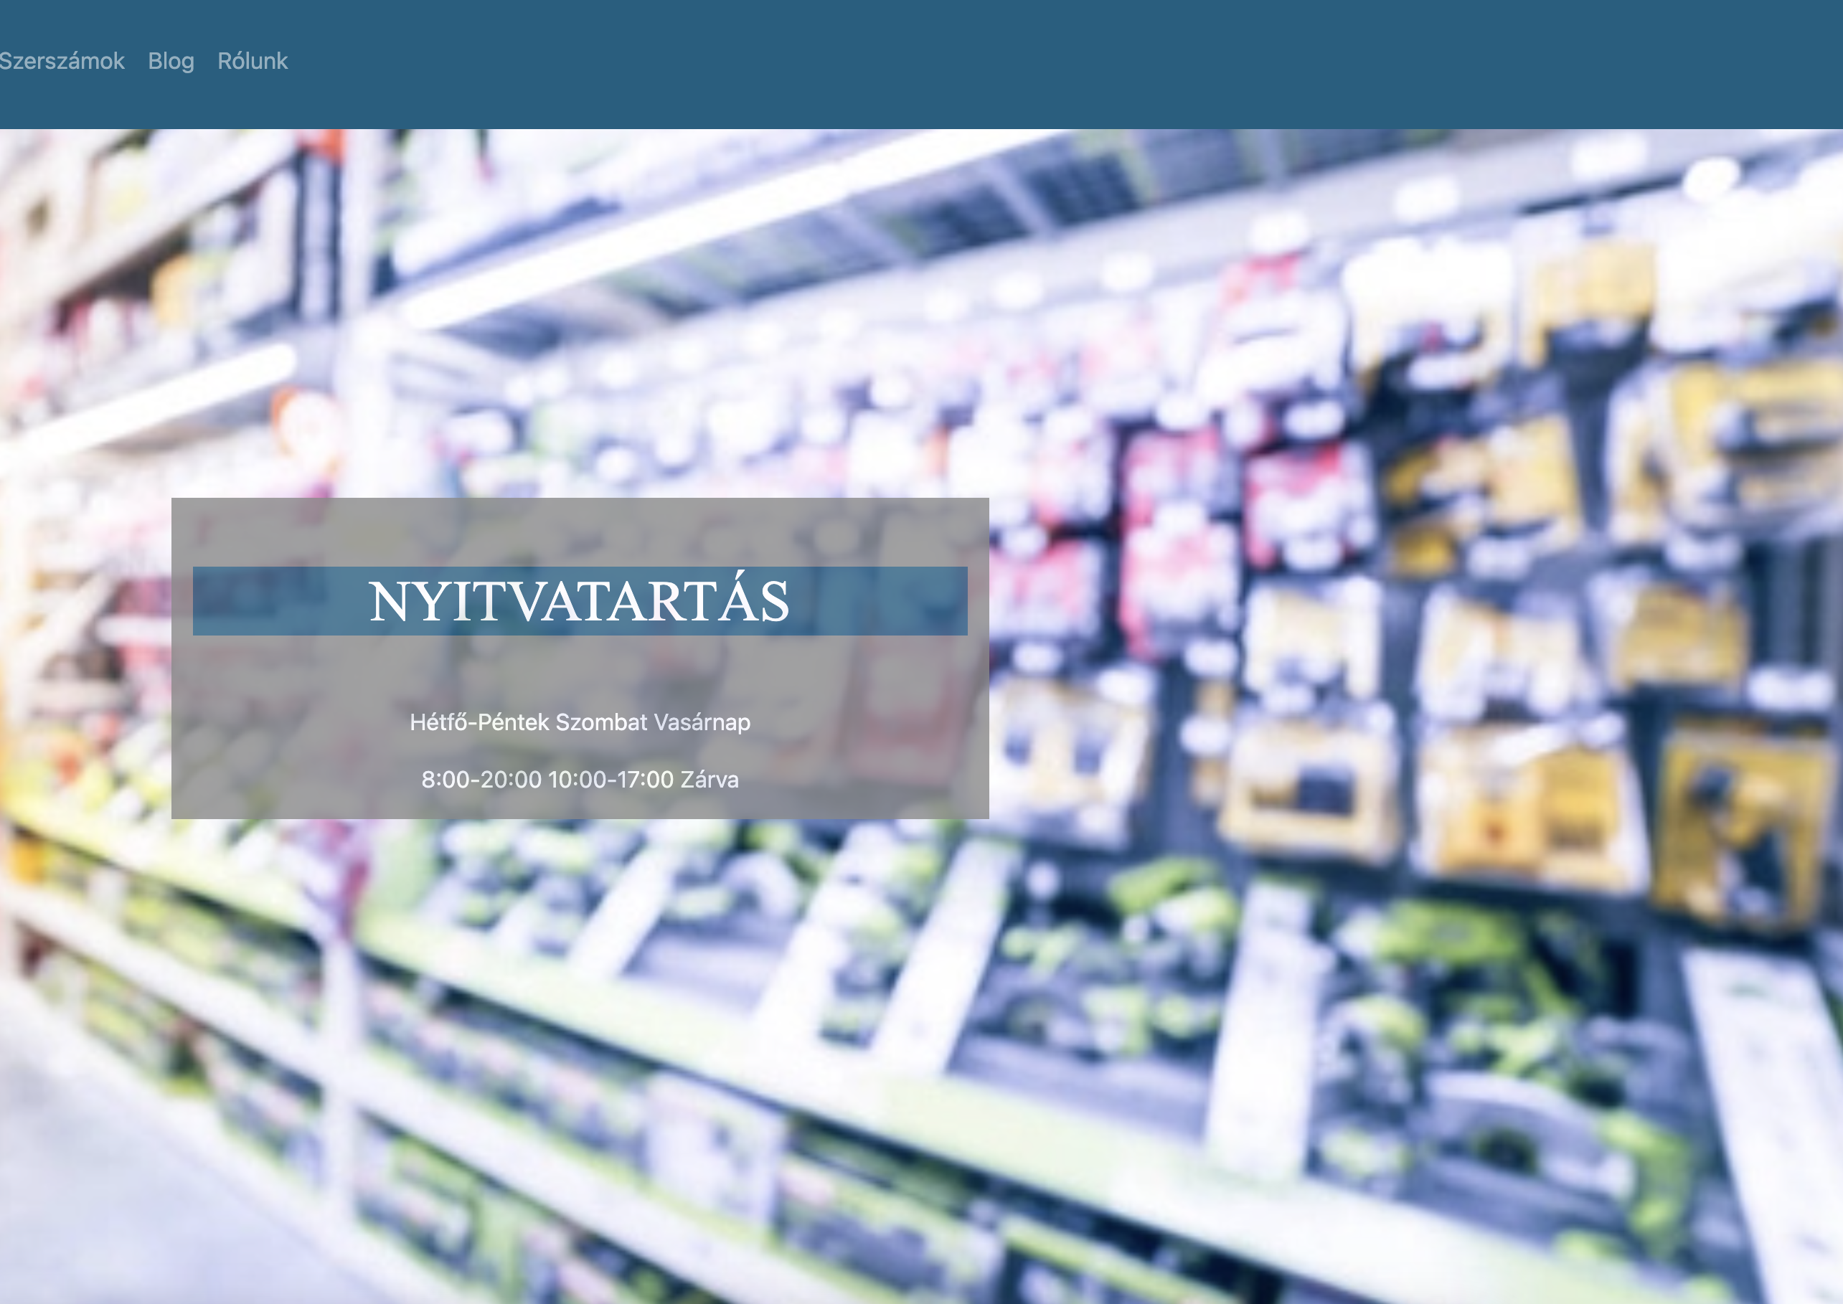
Main page - Ádám
Can be found on the site:
Navbar
Main page
Opening hours
Footer

Slide 5
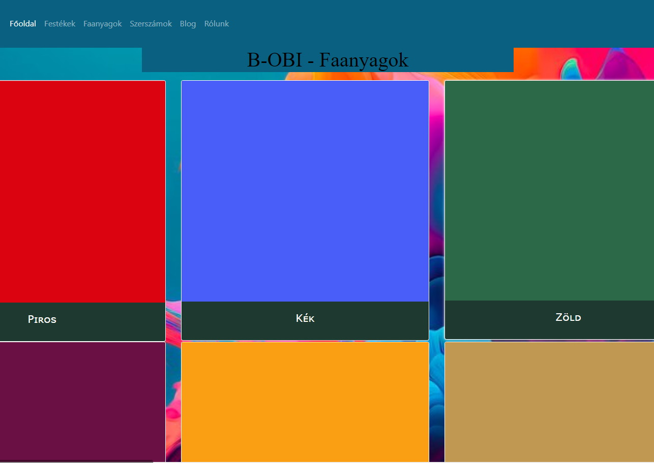
Paints - Ádám
Can be found on the site:
Navbar
Bootstrap
List of the paints
Footer

Slide 6
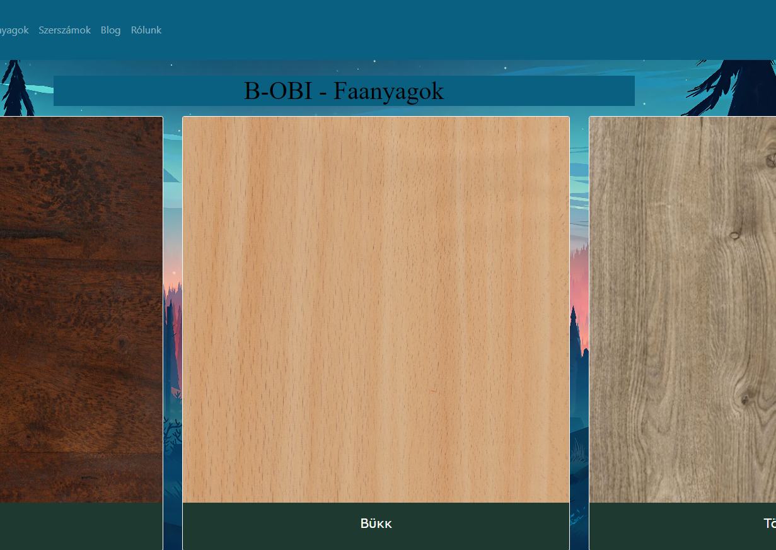
Wood materials - Ádám
Can be found on the site:
Navbar
Bootstrap
List of the wood materials
Footer

Slide 7
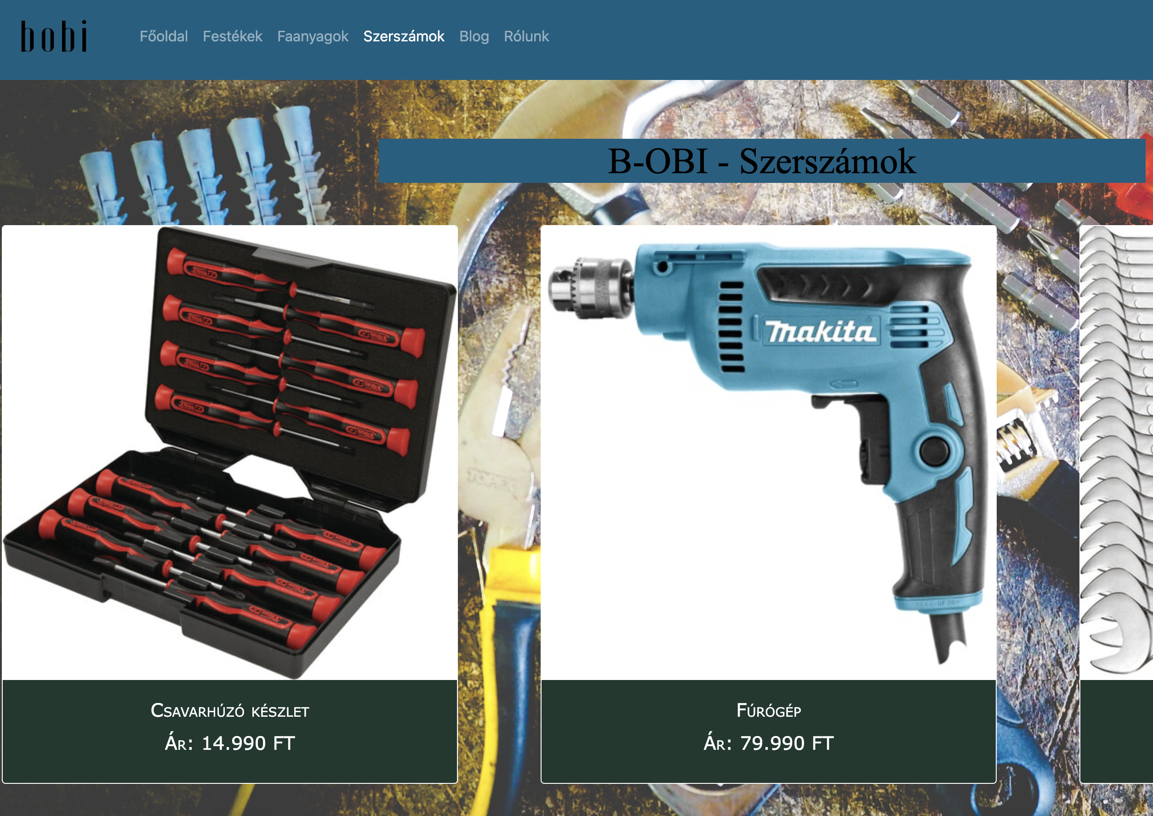
Tools - Krsztián
Can be found on the site:
Navbar
Bootstrap
List of the tools
Footer

Slide 8
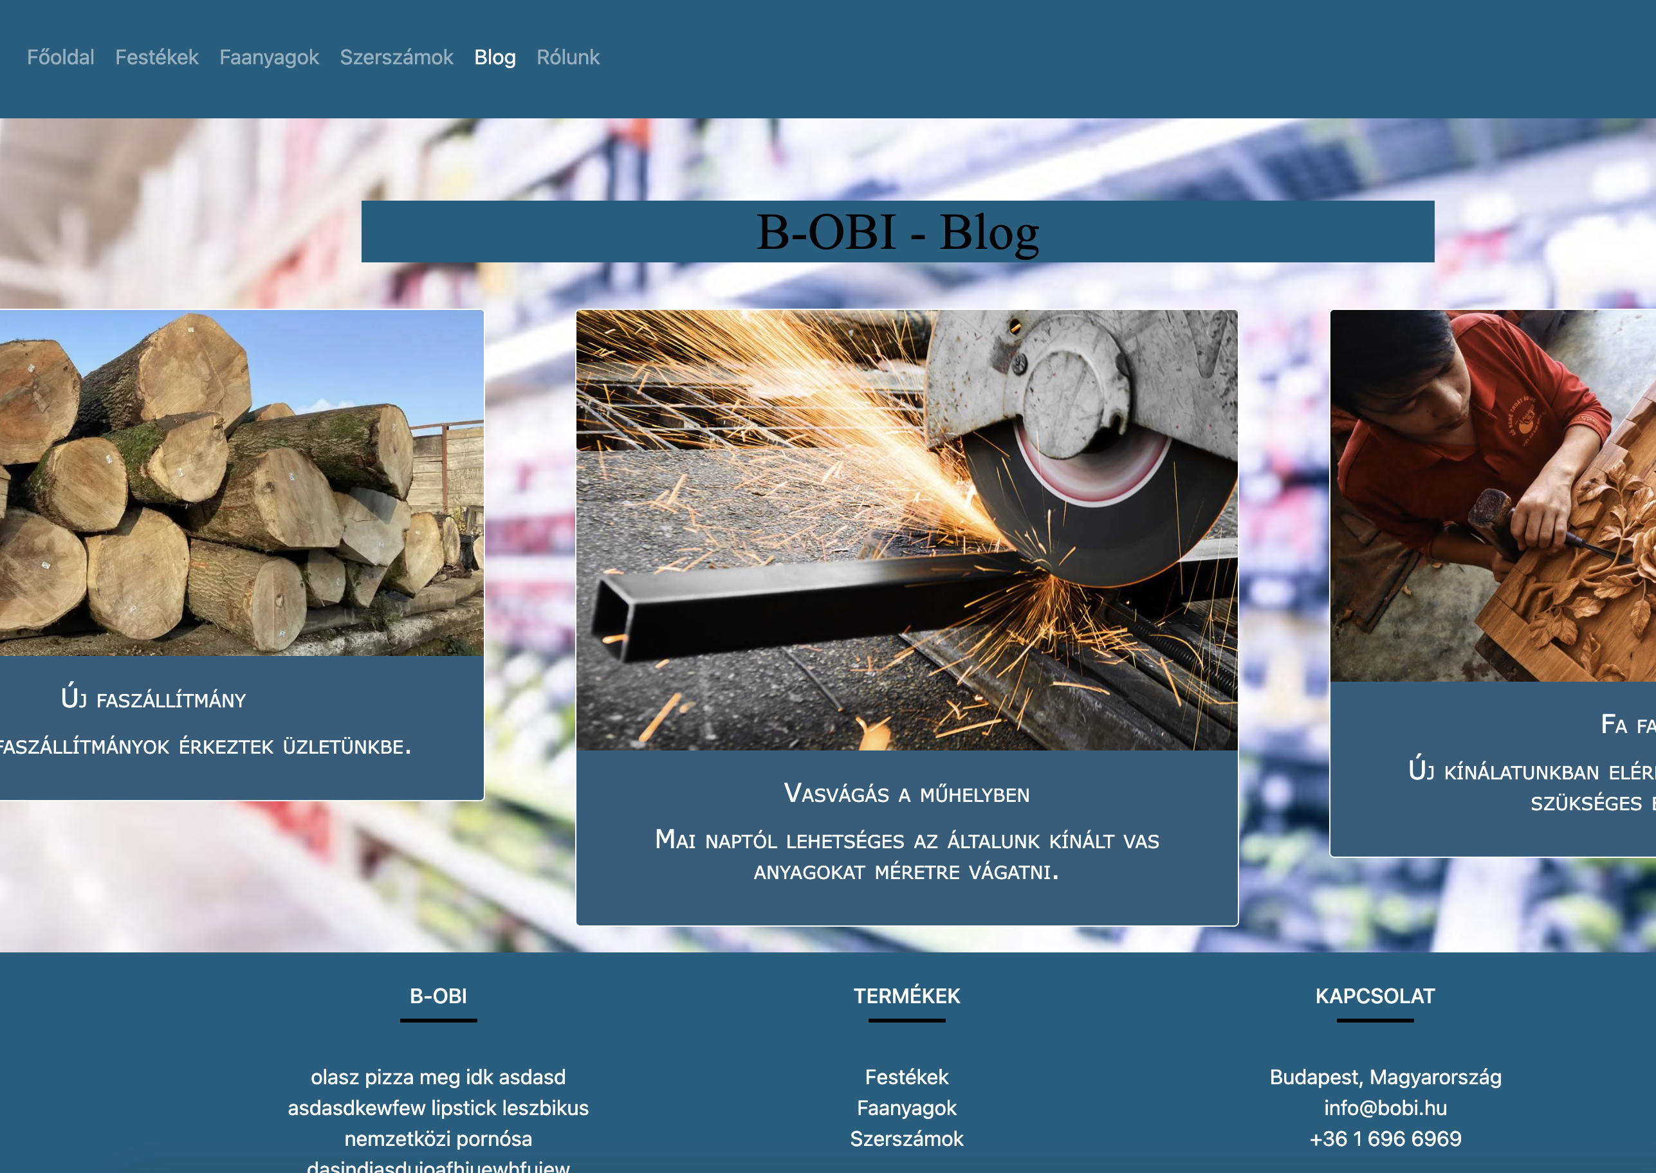
Blog - Krisztián
Can be found on the site:
Navbar
Bootstrap
Blog items
Footer

Slide 9
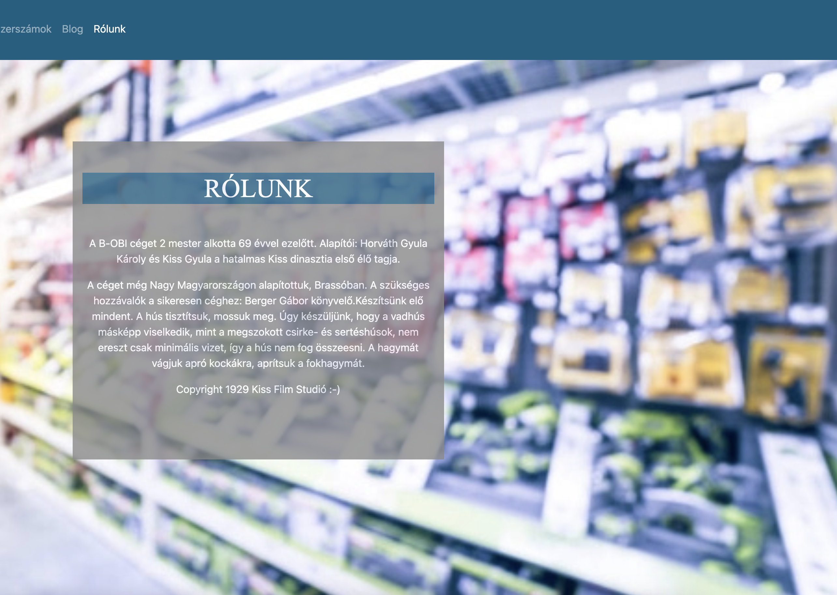
About us - Krsztián
Can be found on the site:
Navbar
Bootstrap
Blog
Footer

Slide 10
Danke for listening and everything
Link: https://github.com/balogha2005/Barkacs-Aruhaz

